Slide 1
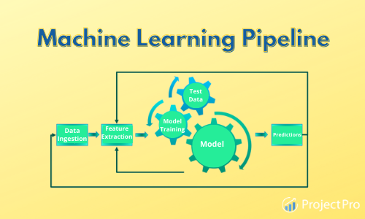
PIPELINE IN ML
By Himanshu Shukla (Data Scientist)

Slide 2
ML Pipeline has many definitions depending on the context. In this lecture, ML Pipeline is defined as a collection of preprocessing steps and a model. This means when raw data is passed to the ML Pipeline, it preprocesses the data to the right format, scores the data using the model and pops out a prediction score.

Slide 3
What is the pipeline
When we managed or arranged our data preprocessing steps in a series or in a particular order . Or we can say when we put all these steps in a pipe through which our data pass every time and reached or final step of prediction is called pipeline.

Slide 4
What is the use of pipeline
At the time train the model we do lots of transformation in our data set or we can say that we prepared our data for machine learning. After preparation we do model fitting .and then we predict outcome.
We know that mostly our data comes with no. of problems in different –different column. So we have to deal each column separately.
Some column have missing value, some have categorical column , some have scaling problem and so on. Sop we have to do some treatment of that columns.
Let suppose we have to do 5 transformation in our data.
1-Imputation
2-one hot encoding
3-Min-Max Scala
4-Feature selection
5-Model Fitting
These 5 steps we have to do each time when ever we have input data. So we have to do these transformation again and again . This way is not professional and if you changed some steps so you will ruined your model . That why we used pipeline for this work.

Slide 5
So what we do?
We make one pipeline in which we fixed these transformation and when ever any new data entry will come we will send that entry from this pipe it will automatically face these transformation and predict output.
1-Imputation
2-one hot encoding
3-Min-Max Scala
4-Feature selection
5-Model Fitting
Prediction
Data

Slide 6
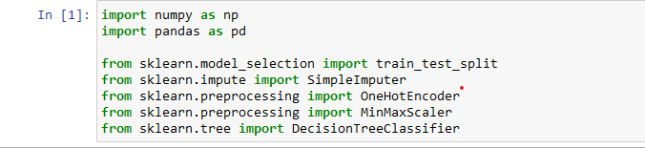
Now we will take titanic dataset for understand this pipeline
First we will see modeling without pipeline
So first we import important library which we need for modeling

Slide 7
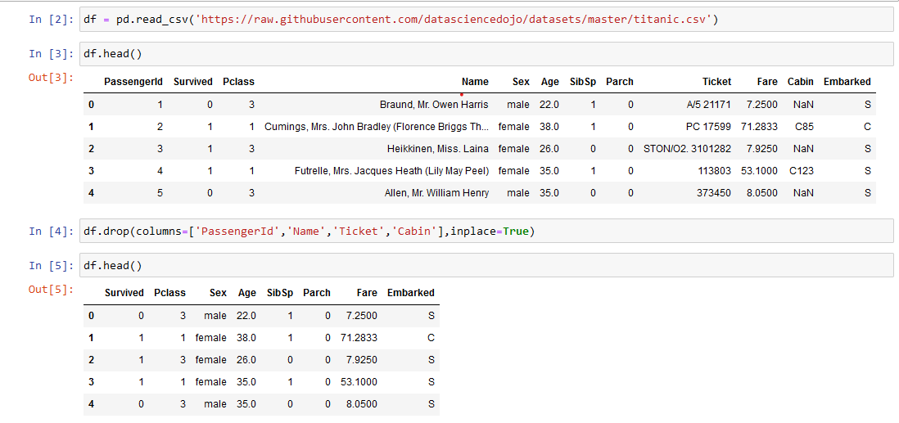
Import data set and drop columns which is not useful for our model prediction

Slide 8
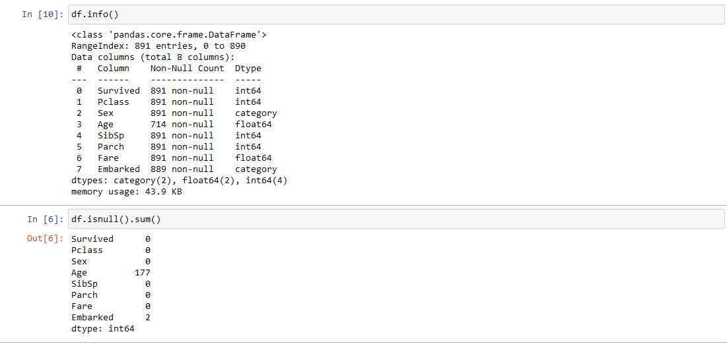
Now we can see that sex and Embarked have categorical column for that we have to do encoding and age column have null value for that we have to impute.

Slide 9
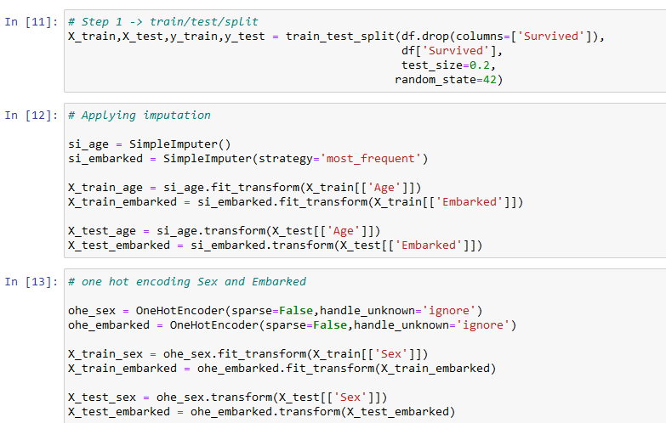

Slide 10
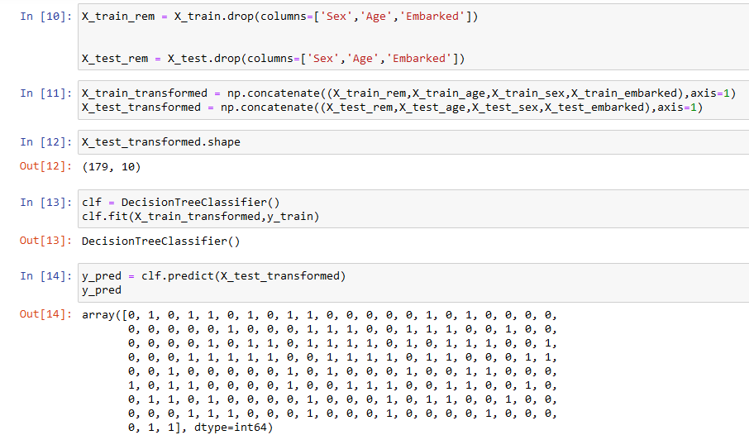

Slide 11
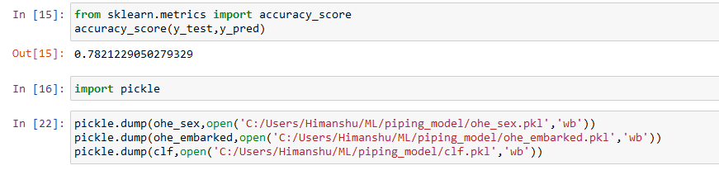
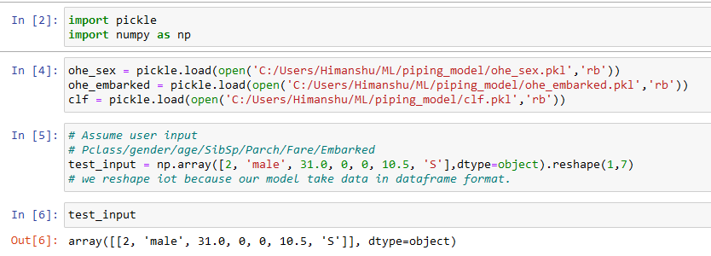
Pickle is used to deploy the model
Now predict

Slide 12
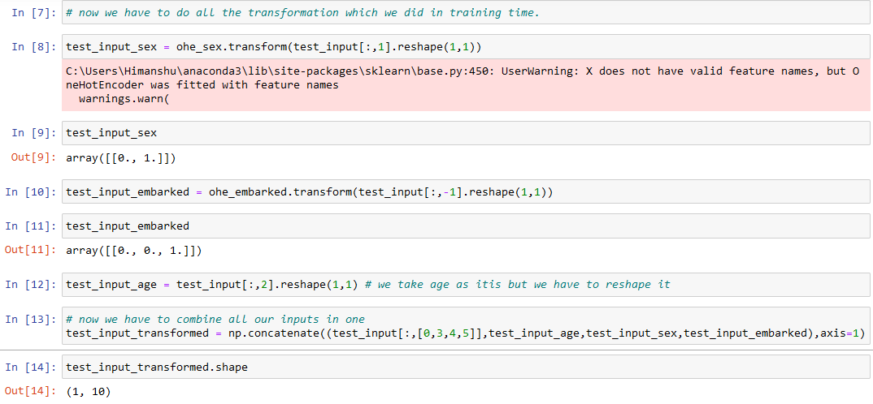
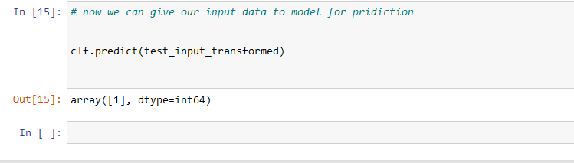
We have to apply transformation once again
We have to apply transformation once again
We are repeating all steps which we were doing at training data.

Slide 13
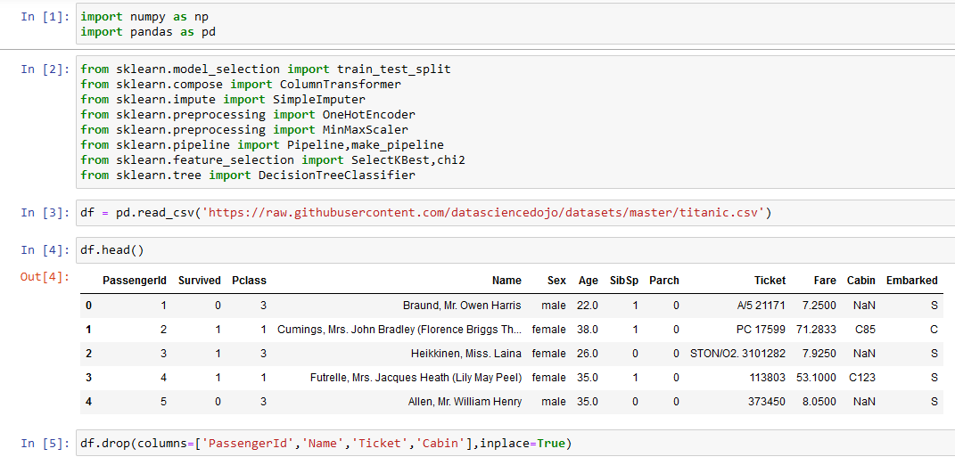
Modeling with Pipeline

Slide 14
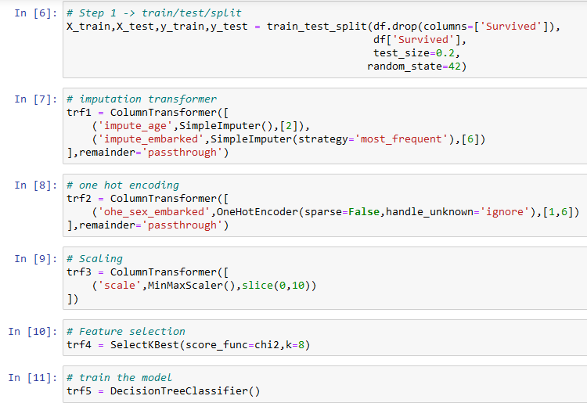
We will use Column Transformer option which comes from sklearn compose.
In this first we will give name and then transformer name and then column position (not column name) and in last remainder (remainder means we are passing that column as it is on which we are not applying transformation.)
There are 5 steps we are doing in data preparation

Slide 15
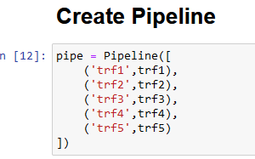
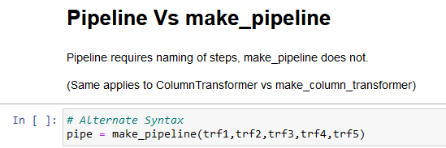
No we will create pipeline
Pipeline comes from sklearn
Alternate way of create pipeline

Slide 16
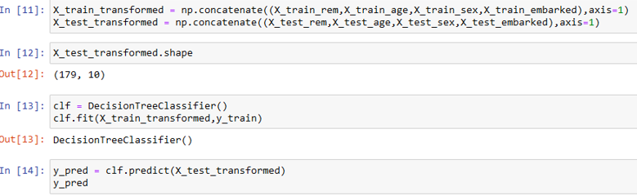
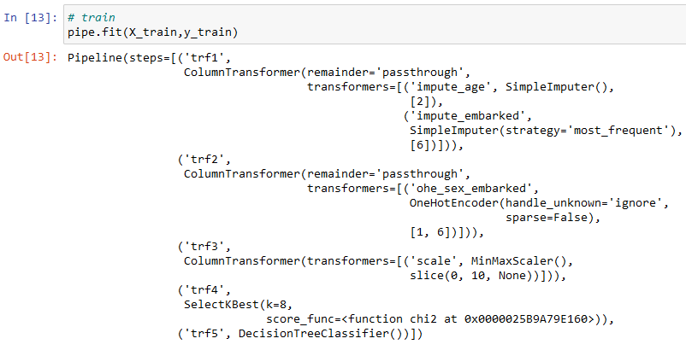
Remember what we did in previous coding when we were doing without pipeline

Slide 17
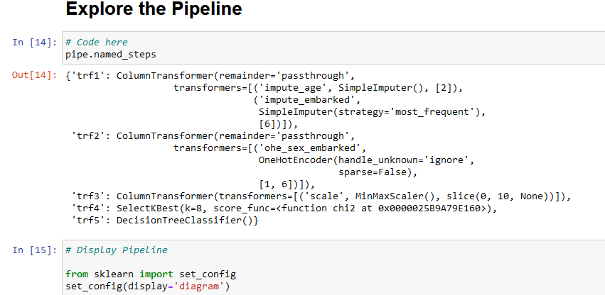
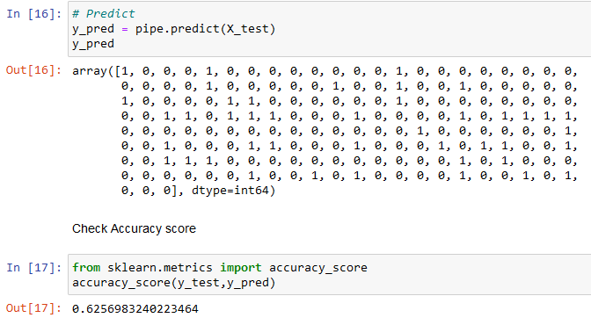

Slide 18
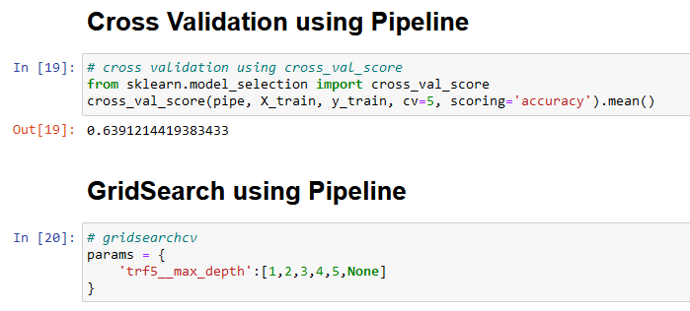
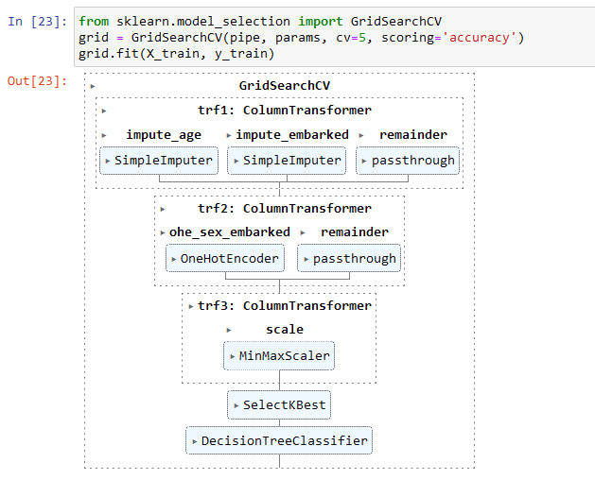

Slide 19
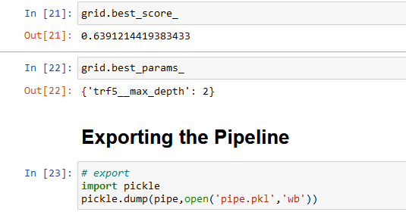
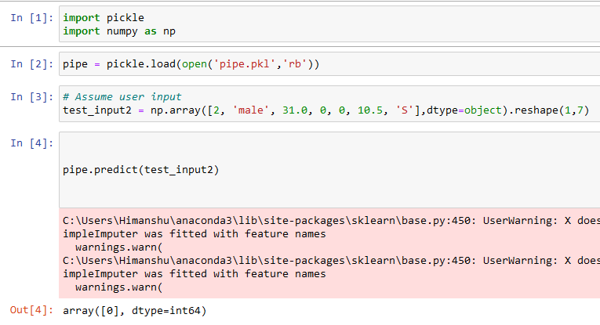
Remember for prediction how much pain we toked when we are doing without pipeline

Slide 20
THE END

